Slide 1

Attijariwafa Bank Data Pipeline
A Hybrid, Real-Time & Batch Data Platform for Retail Banking

Slide 2


Executive Summary
Platform Overview
This hybrid platform unifies ATM, card, wallet, and out-of-cash transaction data using a modern medallion architecture (Bronze/Silver/Gold).
Key Outcome
Processes 17M+ transaction records.
A fully portable transformation layer validated against three cloud targets with zero logic duplication, orchestrated via Apache Airflow.
Hybrid execution: Local (DuckDB) to Cloud (Snowflake/Fabric).
184 automated dbt tests ensuring 100% data quality.
Real-time Kafka alerting for out-of-cash events.

Slide 3

Project Overview
Design Philosophy
The platform follows the "Write Once, Run Anywhere" principle. The choice of warehouse is a configuration detail, not an architectural commitment.
Core Stack
Built using PySpark, Delta Lake, and dbt. Every rule is written once and runs everywhere.
Modeled on a mid-sized Moroccan retail bank, supporting 2,000 customers and 6,146 active cards across 12 regions.

Slide 4






The Challenge: Data Silos
Fragmentation
Key Resolution
High Latency
Inconsistent semantics across ATM, Card, and Wallet gateways.
Missing link between masked PAN numbers and customer master records.
Batch refreshes were too slow for critical out-of-cash ATM events.

Slide 5
System Objectives
Primary Goals
Extended Goals
Build a portable 3-layer Medallion pipeline.
Benchmark Snowflake vs. Microsoft Fabric.
Implement all business logic in dbt.
Kafka-based real-time ingestion path.
Automated test-driven data quality framework.
Operational monitoring with Grafana.
Orchestrated landing-to-gold flows via Airflow.
Containerized deployment via Astronomer.

Slide 6


System Architecture
The architecture unifies batch and streaming flows into a shared Medallion structure.
Ingestion: Kafka + PySpark
Storage: Delta Lake (S3/Local)
Compute: DuckDB / Databricks

Slide 7
Hybrid Execution Parity
Layer | Local Engine (Dev) | Cloud Engine (Prod)
Compute | PySpark / DuckDB | Snowflake / Fabric
Storage | Local Filesystem | ADLS Gen2 / S3
Transformation | dbt-duckdb | dbt-snowflake
Orchestration | Astronomer (Local) | Managed Airflow

Slide 8

Local Dev Efficiency
Why DuckDB?
Chosen for its embedded, zero-admin nature and native Delta Lake reader.
Development cycles reduced from minutes (Cloud) to seconds (Local) using DuckDB's in-process engine.
Respects Delta transaction logs.
SQL dialect parity with Snowflake.
Near-zero latency for local testing.

Slide 9

Medallion Pipeline Layers
Bronze • Silver • Gold

Slide 10
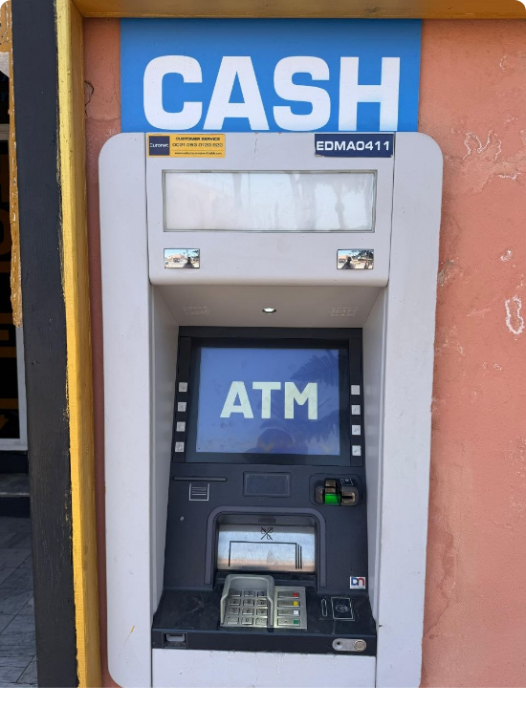
Bronze: Raw Ingestion
The Source of Truth
Consolidates Parquet batches into queryable tables without any transformation.
159 ATM Masters
4.06M Card/ATM Trans
13.3M Historical Trans (Kaggle)
63.8K Out-of-Cash events

Slide 11



Silver: Clean & Valid
Normalization
Deduplication
Quarantine
Currency parsing (MAD extraction) and column type casting.
Window-function logic based on natural transaction keys (REFNUM).
Malformed records (negative amounts) are routed to audit tables.

Slide 12

Gold: Dimensional Model
The Analytical Hub
SCD Type 2
Built with dbt to provide high-performance marts for Power BI consumption.
Tracking customer demographics and card status changes over time to reconstruct historical risk profiles.
Fact Tables: ATM/Card/Wallet/OOC.
Dimensions: Customer, Card, Merchant, Geography.
Marts: Fraud Risk, ATM Performance.

Slide 13
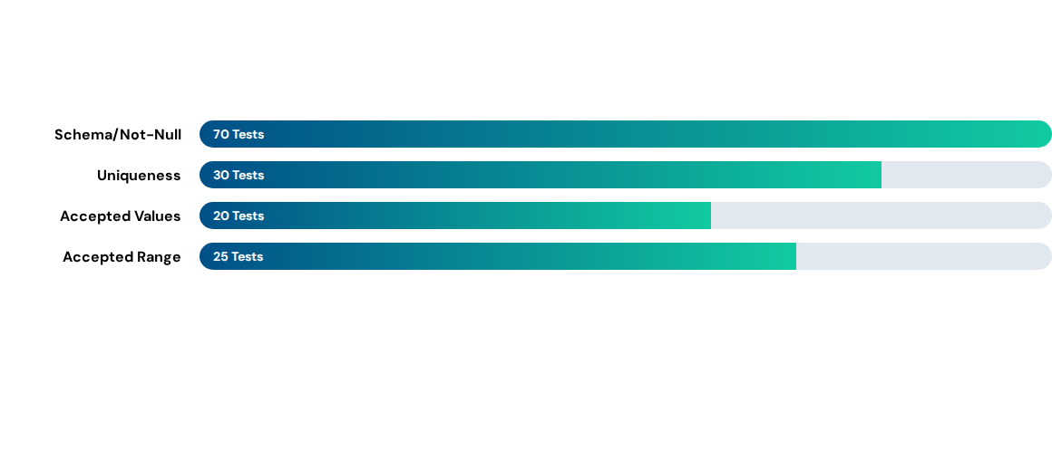
Data Quality Assurance
Total: 184 passing dbt tests covering schema, referential, and business logic.

Slide 14

Debugging Discipline
Case #1: Duplicates
Case #6: Silent Loss
Delta Lake's file-versioning caused stale files to be read. Fix: Switched to DuckDB's delta_scan().
Registration macros succeeded but never committed. Fix: Added explicit SQL COMMIT statements.

Slide 15
Cloud Benchmarking (CDC)
Comparison of Gold-layer build performance using shared Silver storage.
Metric | Azure Fabric | Databricks | Snowflake
CDC Latency | Low | Native | Medium (Stage)
Query Perf | High | Ultra-High | Excellent
Scale Mode | Serverless | Unified Lake | Elastic WH

Slide 16
Real-Time Kafka Flow
Out-of-Cash Alerts
Kafka decouples event producers from the alerting consumer to provide sub-minute latency.
Operational urgency: An ATM out of cash for 6 hours is lost revenue. Kafka ensures replenishment teams are notified instantly.
Spark Structured Streaming.
Micro-batch writes to Bronze.
Dual Consumption: Speed vs. Completeness.

Slide 17
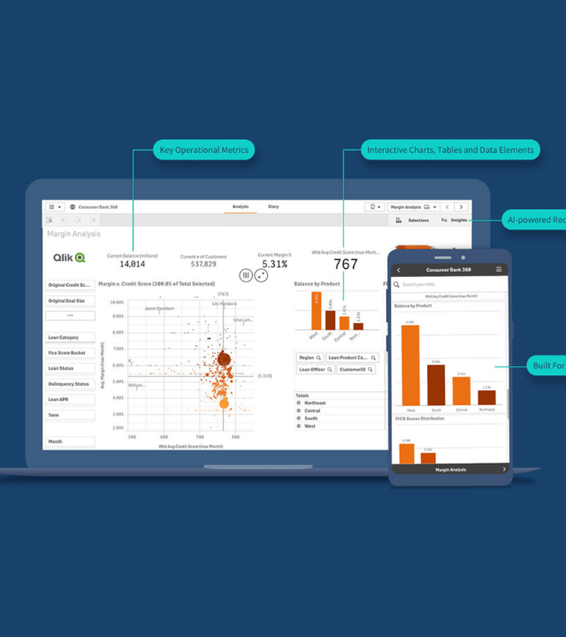
Unified Monitoring
Dual tracking for engineering and business stakeholders.
Grafana: Pipeline task health and row counts.
Power BI: Fraud scoring and ATM replenishment analysis.

Slide 18

Security & Compliance
PII Protection
Stringent controls on sensitive banking data.
PAN masking at ingestion.
Income column-level restriction.
Role-Based Access Control (RBAC).
Encryption-at-rest in ADLS.

Slide 19



The Path Forward
Machine Learning
Anomaly Detection
Cost Optimization
Replace rule-based scoring with trained Fraud detection models.
Automated statistical drift detection on transaction distributions.
Workload-aware routing between Fabric and Snowflake.

Slide 20

Thank You
Questions & Discussion
Team: Mahmoud Saad • Alfred Farag • Mariam Safwat • Zainab Mohamed
Attijari wafa Bank Data Pipeline © 2026

Slide 21





Image Sources
https://images.stockcake.com/public/3/c/1/3c1f0bc5-1a71-441a-a983-4764f59571ce_medium/neon-pipeline-network-stockcake.jpg
Source: stockcake.com
https://moroccantraveltrips.com/wp-content/uploads/2026/06/ATM-Euronet.jpg
Source: moroccantraveltrips.com
https://assets.qlik.com/image/upload/w_2378/q_auto/qlik/glossary/dashboard-examples/seo-hero-financial-dashboards_ttulhs.png
Source: www.qlik.com
https://thumb.r2.moele.me/t/31917/31907905/a-0005.jpg
Source: www.motionelements.com
https://static.vecteezy.com/system/resources/previews/077/899/152/large_2x/african-american-and-asian-colleagues-work-side-by-side-analyzing-source-code-and-data-on-desktop-monitors-focused-programmers-collaborate-to-enhance-web-development-projects-in-modern-office-photo.jpg
Source: www.vecteezy.com

